Slide 1
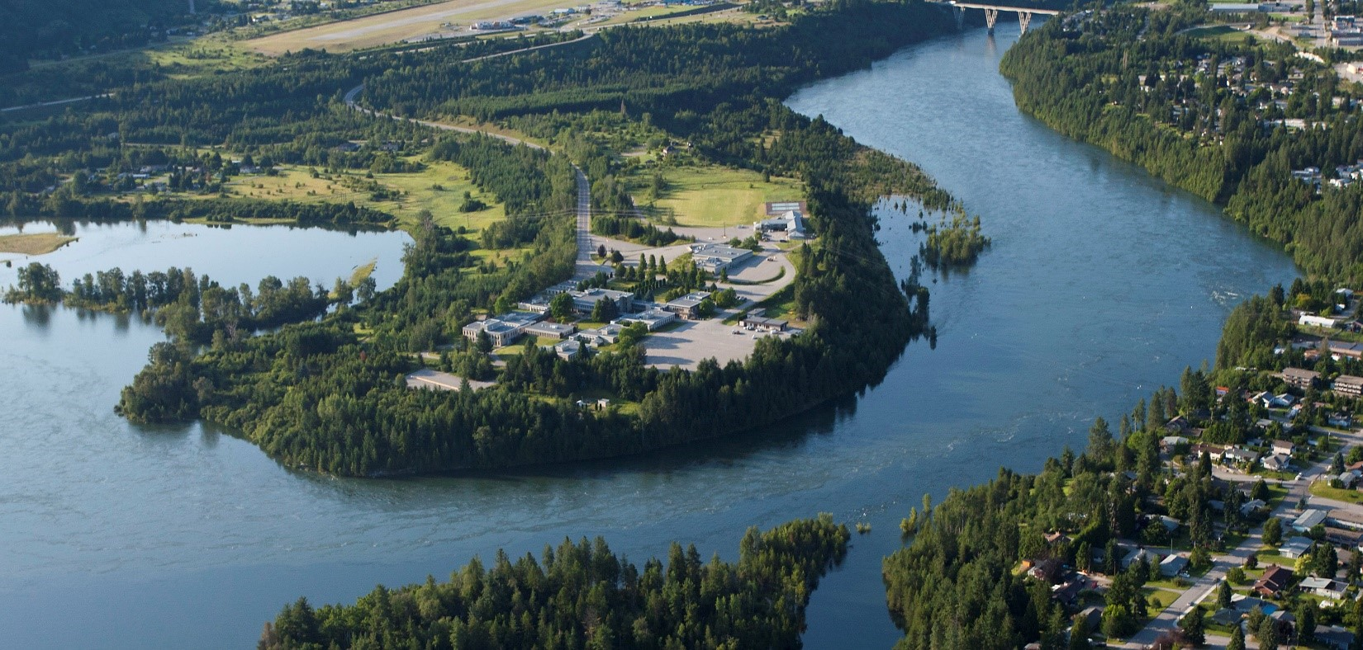
Associate of Science Level Three Review
External Review Committee Meeting
October 20, 2022

Slide 2
Agenda
Time | Topic | Speaker
9 am | 1. Welcome & Territorial Acknowledgement | Duff Sutherland/Allison Alder
9:05 am | 2. Introductions and icebreaker
9:20 am | 3. Summary, review the process and expectations | Duff Sutherland/Allison Alder
9:45 am | 4. Conversation and questions with faculty | Group
10:15 am | 5. Tour lab facilities | Duff Sutherland/Allison Alder
10:30 am | 6. Physics lab with students | Allyson Perrott
11:00 am | 7. Review of recommendations and discussion | Group
11:40 am | 8. External Review Committee Report | Allison Alder
11:50 am | 9. Adjournment
 | Lunch

Slide 3
QAPA Level Three Process
Review of QAPA process and external review team expectations
-Allison Alder, dean
The Associate of Science Level 3 Program Review overview
-Duff Sutherland, school chair
-Review team, faculty
Questions?

Slide 5
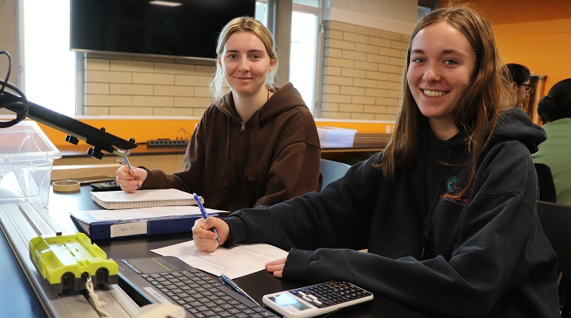
Who is who?
Maggie Matear, president
Allison Alder, dean
Review Team
Duff Sutherland, school chair
Jose Padilla, Modern Languages
Karlie Shaughnessy, English
Kerri Webb, Mathematics
Allyson Perrott, Chemistry
Doug Henderson, Mathematics
James Nicol, Biology
Caroline Barabonow, administrative assistant
AS students
Harshdeep Kaur, Izaiah White
Ripu Garg, Logan Campbell
External Review Committee
Trudy Kavanagh, associate dean, UBCO
Morgan Dehnel, chief scientist and innovation officer, D-Pace
Brendan Wilson, faculty, School of Environment and Geomatics

Slide 6
Self-Study Report Recommendations
Examine increased flexibility in modes of course delivery, selection and offerings.
Align course learning outcomes with program outcomes.
Engage in a study of the transfer experience of individual AS students.
Focus on attracting a higher percentage of domestic students to the program from the college region.
Develop a plan to improve retention into second year.
Promote the renovation of the geology/geography lab.
Promote the renovation/re-organization of the second-year biology lab.
Evaluate increased program coordinator support for the AS program.

Slide 8
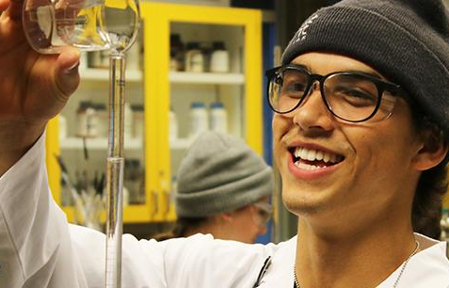
Next Steps (from Self-Study)
Revise self-study report and recommendations following input from external review committee input
Policy and curriculum change will be passed through Education Council and its standing committees
Final report will be shared with the VP Education, the Education Division Leadership group, the School of University Arts and Sciences
Final recommendations will become part of ongoing school and college planning, including school operational plans, facilities and capital plans
Chair and dean will monitor progress on recommendations annually and adjust and needed

