Slide 1
Ricoh Smart Operation Panel Fax

Slide 2
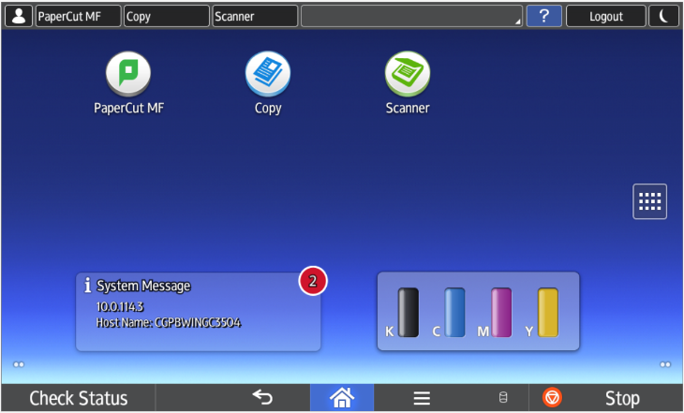
Fax Mode
Press the Fax icon.

Slide 3
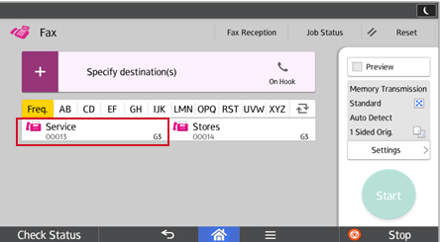
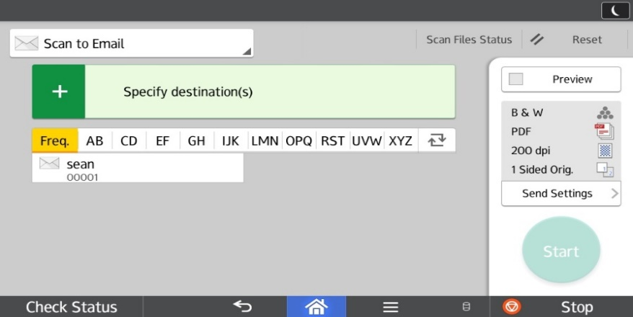
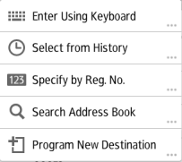
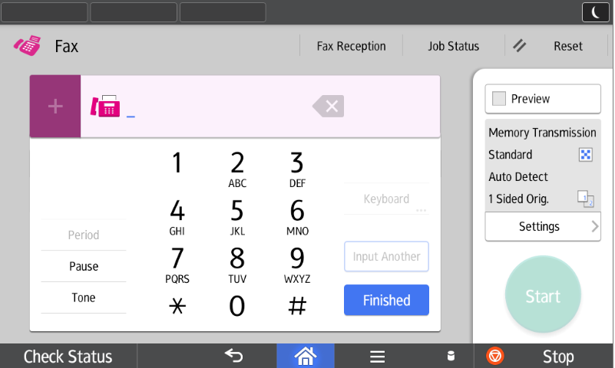
Specify Desintation(s)
Press “+” for drop down.
Select from a pre-programmed destination.
OR
Enter Using Keypad.

Slide 4
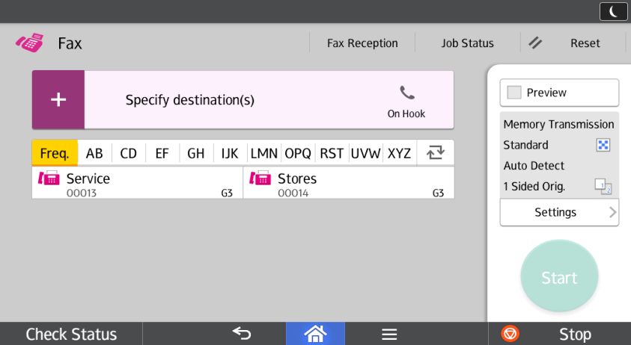
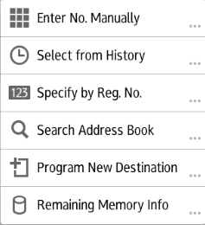
Fax Options
Press the + Key for additional fax options.

Slide 5
Address Book Program New Destination
You may want to add a Quick Key on the front screen for quicker destination access.
Press “+” for drop down.
Select Program New Destination.
Under Email tab press Change, enter address, then OK.
Under Name, press Change, and enter a name for the email display, then OK.
Press Next and select a Title for the email to be stored under :
Frequent adds the programmed email to the main screen.
Selecting an alphabetical title (AB,CD,EF…) displays the programmed email under that title
Press OK at the top of the screen
Press Exit.

Slide 6
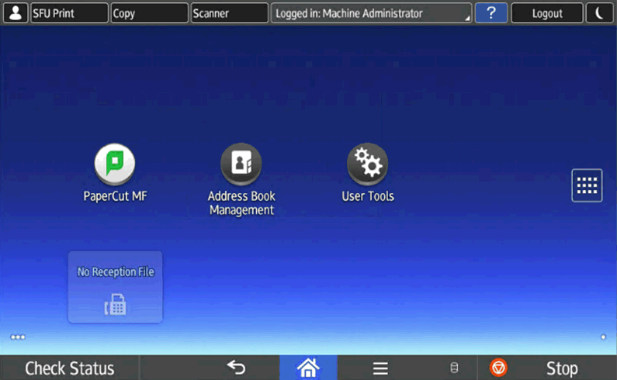
Need to Edit/Delete a contact?
If you need to Edit/Delete someone from the address book, go to Home Page and Select Address Book Management.
(You may need to flip to the second page of screen.)

Slide 7
Preview
Press Preview to review your job before sending the fax.

Slide 8
On Hook
On Hook: allows you to listen to the dial tone so you know you are connected.

Slide 9
Multiple Destinations
+: Allows you to send to multiple destinations if selected in between destinations.

Slide 10
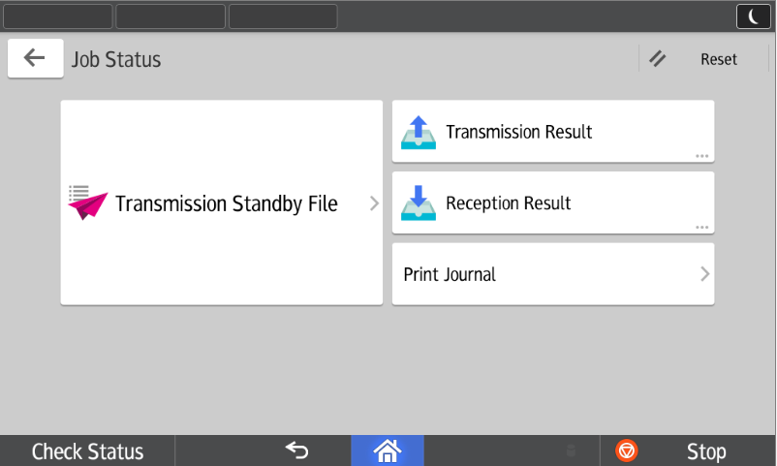
Job Status
Job Status: Select from various status reports.

Slide 11
Fax default settings
The highlighted section shows you the default settings for your fax (ie. One sided)
Press Settings to change your settings.

Slide 12
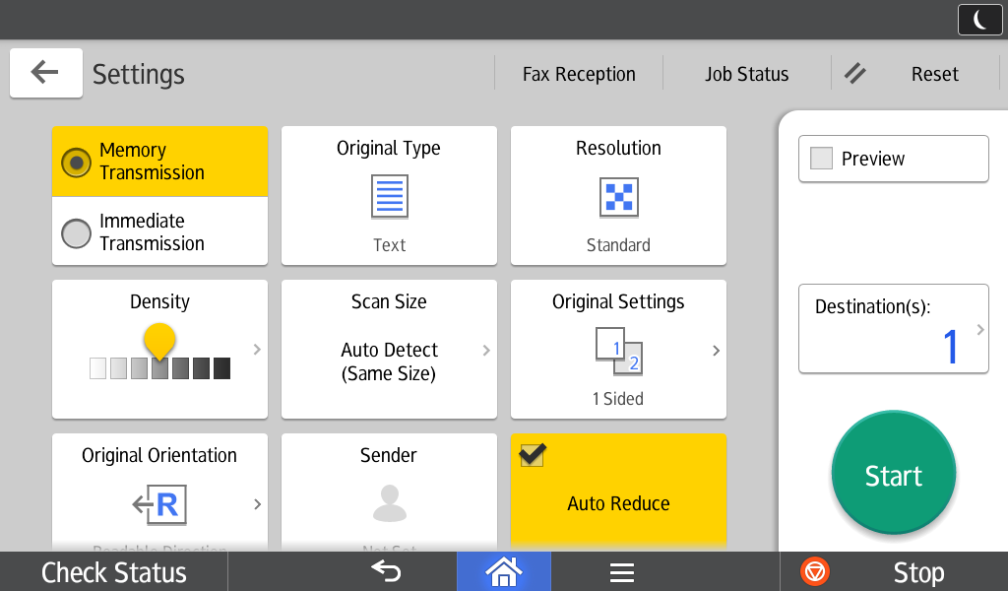
Fax Settings
Memory Transmission: allows you to change from Memory to Immediate sending. (memory will try multiple times to connect)
Original Type: allows you to see the document(s) contain halftones or photos.

Slide 13
Fax Settings continued..
You can adjust the Resolution on your document, so it looks clearer.
By selecting Original Settings, you can change between 1-Sided & 2-Sided Originals.

Slide 14
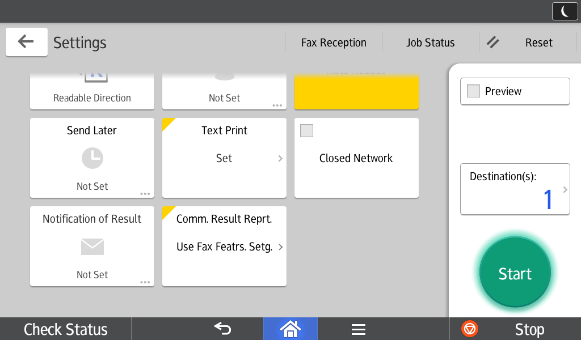
Fax Settings continued..
Use Send Later to send a fax
later, and use an economical
time.
Use Notification of Results to
send an email notification to
you showing fax results. (ie.
Completed or Error)
Use Comm. Results Report
to have the fax confirmation
print or not.
Default is set to use Fax
Features Setting.

