Slide 1
Aboriginal Services at Selkirk College
Working with Elders, Cultural Support Providers and Indigenous Community Partners

Slide 2
Aboriginal Services
Helps create a safe environment for culture to be shared at Selkirk College
Provides a community within the college environment
Works with community service partners to extend the supports available to Aboriginal students
Provides advocacy and support to Aboriginal students
Coordinates cultural programming, events and activities open to all Selkirk College students and staff through the Gathering Place

Slide 3
Role of the Aboriginal Cultural Assistant
Provides advice and cultural support to instructors, schools, community of practices, other departments, and students when planning activities, events and projects with an Aboriginal theme
Makes requests on behalf of the College to Elders, Traditional Knowledge Keepers and other cultural service providers with individuals that the college has an agreed upon process and protocol with.

Slide 4
Elders and Cultural Activity Facilitators
There are some shared cultural practices between First Nations
Communities usually have designated Elders and Knowledge Keepers that specialize in the traditions of their specific Nation
Often times Elders and Knowledge Keepers have different roles and they are highly valued members of their communities

Slide 5
“An Elder is very respected and often consulted on various issues within the community. Each Elder has their own special knowledge and often must consult other Elders on issues outside of their specialty to provide a consultation to anyone who asks.” University of Lethbridge, June 2013. Blackfoot and First Nations Metis and Inuit Protocol Handbook, Aboriginal Education Committee

Slide 6
Different Roles
While some Elders may provide a single service or have a one specialization, others may provide multiple services or have a vast field of expertise
Do not assume that each person is an expert in all areas related to their culture
A person may have a specialty or expertise and these people are not necessarily Elders
Being an Elder in a community is a very special designation and the term should not be used lightly

Slide 7
Different Roles (cont.)
Here are some examples of different types of Elders and Knowledge Keepers:
TEKK or TKK (Traditional Ecological Knowledge Keeper or Traditional Language Keeper)
Story Teller
Orator
Herbalist
Tradition Teacher
Traditional Artist
Advisor
Spiritual Elder

Slide 8
Examples of Different Practices and Services
ceremony
prayer (opening, closing, meal time or blessing)
welcome
traditional knowledge sharing
class instruction
advising
counseling

Slide 9
Requesting Services
Many Elders and Traditional Knowledge Keepers are very busy and have a specific protocol for requesting their services. These request may include a tobacco offering, an in person visit or contacting their designated liaison

Slide 10
Planning a Guest or Event / Giving Notice
By coordinating with Aboriginal Services and the Gathering Place there is an increased chance of maximizing the guests availability to other students and faculty while they are on campus . ( This is particularly important if they are traveling a distance)
By working with Aboriginal Services there may also be an opportunity to share the cost of the honorarium and help provide additional support including a offering of food and whatever else they may need.
Please give six to eight weeks notice when requesting services from Aboriginal Services so that the Gathering Place programming may be adjusted or accommodated and also out of respect to the people we are requesting a visit from.

Slide 11
Greeting an Elder or Traditional Knowledge Keeper Upon Arrival
It is important that there is a designated person to support an Elder or Traditional Knowledge Keeper during their visit at Selkirk College. This person would make sure that the guest has everything that they need to be comfortable and that they know their way around the college.
The designated person should be well educated regarding the cultural protocols and what the Elder or Traditional Knowledge Keeper is used to and should be flexible and not be limited by time constraints .
The Aboriginal Cultural Assistant can act as the support person or work with an individual interested in learning about protocols and how to be the designated greeter/attendant to Elders on campus. Sometimes Elders have their own assistants/support people that help them.

Slide 12
Tobacco and Gifts
Tobacco is presented before a presentation to acknowledge the sacredness of the visit
Tobacco offerings can be found in the Gathering Place on the alter in the ceremony room. There is a basket with some small pre-made bundles, or if an instructor would rather wrap their own, they can do so with the supplies available on the alter.
At the end of the class/college visit, Elders are given an honorarium and a small meaningful gift in gratitude of their offering
Sometimes Elders and Knowledge keepers have specific preferences. Aboriginal Cultural Assistant can help work out the details with the Elders prior to the visit.

Slide 13
“Historically, Elders were given food, clothing and other necessities in exchange for their help, and therefore monetary gifts are now acceptable... it is extremely difficult to place a dollar value on sacred knowledge and ceremony.” University of Alberta, February 2012. Elders Protocols and Guidelines Council of Aboriginal Initiatives, University of Alberta

Slide 14
Honorariums
Outside of a traditional context, Selkirk College provides an exchange in the form of money
This requires extreme care when requesting personal information from Elders
The Aboriginal Cultural Assistant will work directly with the Elders or service providers to do this in a good way

Slide 15
Honorariums (cont.)
Elders do not share their teachings or provide advice and services in their communities to make money
They provide the gift of knowledge, perspective and experience
They are highly valued members of the community
In return for their important contributions to their communities, Elders are cared for by the community

Slide 16
Honorarium Guide
Depending on the situation, there may be some flexibility with the honorarium amount. By working in partnership with Aboriginal Services when hosting a guest, we are able to maintain consistency with the Elders and services providers that we work with on a regular basis. Some service providers attend classes as a employee representative of their place of work and do not receive an honorarium. They would still receive a tobacco offering at the start of the class and gift at the end. Aboriginal Services works with the following honorarium guide.
Visits and services rendered for up to an hour: $50 - $100 (may vary)
Visits and services rendered for between 2 - 4 hours: $200 - $400 (may vary)
Services rendered for a full day: To be negotiated on an individual basis with the Elder or TEKK.

Slide 17
Travel Expenses
In some instances travel expenses will also need to be provided. Depending on the distance that the Elder or the Traditional Knowledge Keeper will be traveling, the travel costs can range between $30 up to $300 for out of town guests. Guests may also require meals and overnight accommodations. Please contact Aboriginal Services for further information.

Slide 18
Duty to Consult
“Inclusion of Aboriginal community is key to ensuring active participation and ownership in effecting the required change. In order to create systemic change, public post-secondary institutions and Aboriginal communities will need to work in partnership, in relationships based on mutual respect, to identify opportunities and to ensure that First Nations, Métis and Inuit knowledge systems, language and culture are respected in research and curriculum change processes.” http://www.aved.gov.bc.ca/aboriginal/docs/Aboriginal_Action_Plan.pdf

Slide 19
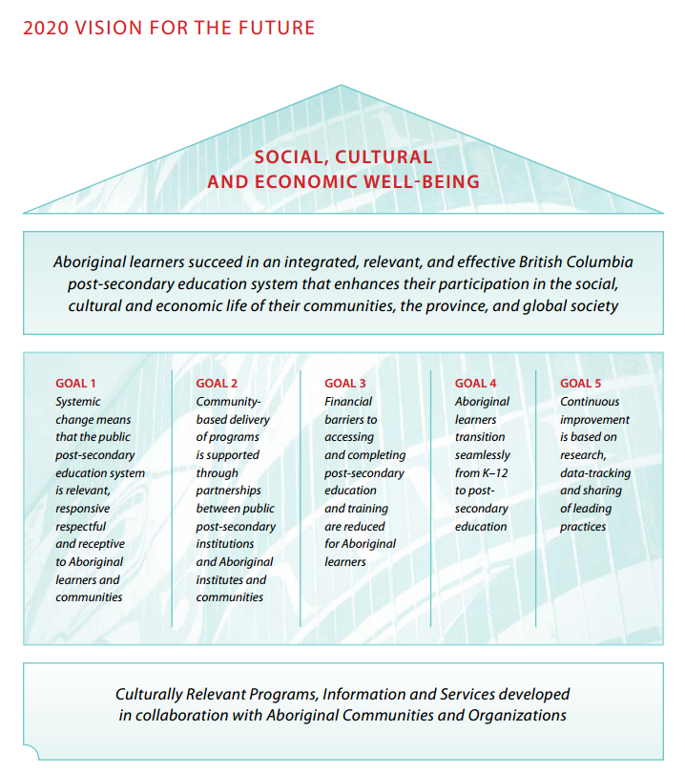
http://www.aved.gov.bc.ca/aboriginal/docs/Aboriginal_Action_Plan.pdf

Slide 20
Requesting support from Aboriginal Services or Booking the Gathering Place
Email or phone Aboriginal Services – 250-365-1357 or jmorin@selkirk.ca (6 – 8 weeks notice)
Visit “My Selkirk” for more Aboriginal Services and Gathering Place Resources

Slide 21
References
Saskatchewan Learning, March 2001. Aboriginal Elders and Community Workers in Schools - A Guide for School Divisions and Their Partners, Community Education, Saskatchewan Education
University of Alberta, February 2012. Elders Protocols and Guidelines Council of Aboriginal Initiatives, University of Alberta .”
University of Lethbridge, June 2013. Blackfoot and First Nations Metis and Inuit Protocol Handbook, Aboriginal Education Committee
Aboriginal Post-Secondary Education and Training Policy Framework and Action Plan 2012, 2020 Visions for the future, British Columbia http://www.aved.gov.bc.ca/aboriginal/docs/Aboriginal_Action_Plan.pdf

