Slide 1
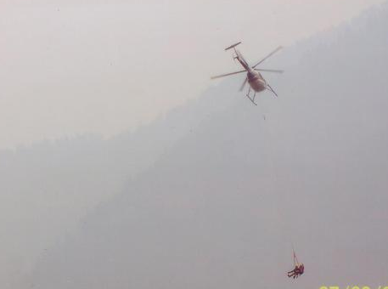
© Dr Delia Roberts 2011
Chronic Occupational Under-Hydration:
© Dr Delia Roberts 2011
© Dr Delia Roberts 2011
© Dr Delia Roberts 2011
When Performance Becomes an Issue
© Dr Delia Roberts 2011
of Health and Safety
© Dr Delia Roberts 2011
© Dr Delia Roberts 2011
Delia Roberts, PhD, FACSM
© Dr Delia Roberts 2011

Slide 2
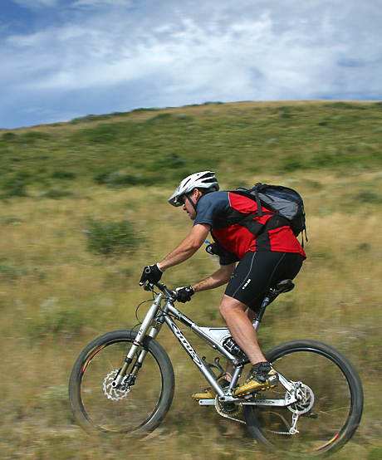
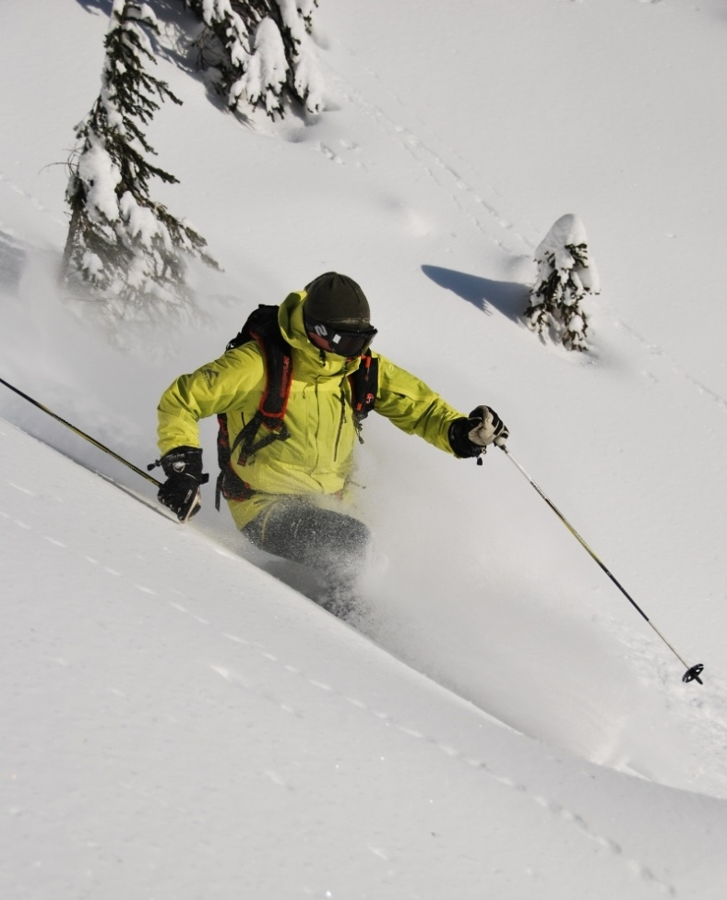
Hydration and Performance
© Dr Delia Roberts 2011
© Dr Delia Roberts 2011
Strong link established in sport
Performance impacted with only 2% loss body mass
80 kg male = 1.6 kg loss
60 kg female = 1.2 kg loss
Physical
Time to exhaustion was reduced by 8% at 20°C
© Dr Delia Roberts 2011
© Dr Delia Roberts 2011
© Dr Delia Roberts 2011
© Dr Delia Roberts 2011
© Dr Delia Roberts 2011
© Dr Delia Roberts 2011

Slide 3
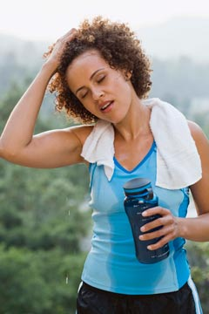
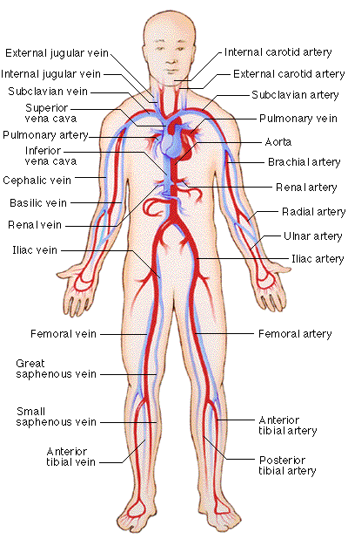
Average 5-6 L Blood
© Dr Delia Roberts 2011
© Dr Delia Roberts 2011
Working muscle requires increased supply
Blood flow to extremities must be maintained to release heat
Increased cardiovascular load
Circulation is impaired
Fatigue
Disrupted brain function
Decreased release of heat
Cells donate fluid but function is reduced
© Dr Delia Roberts 2011
© Dr Delia Roberts 2011
© Dr Delia Roberts 2011
© Dr Delia Roberts 2011
© Dr Delia Roberts 2011
© Dr Delia Roberts 2011

Slide 4
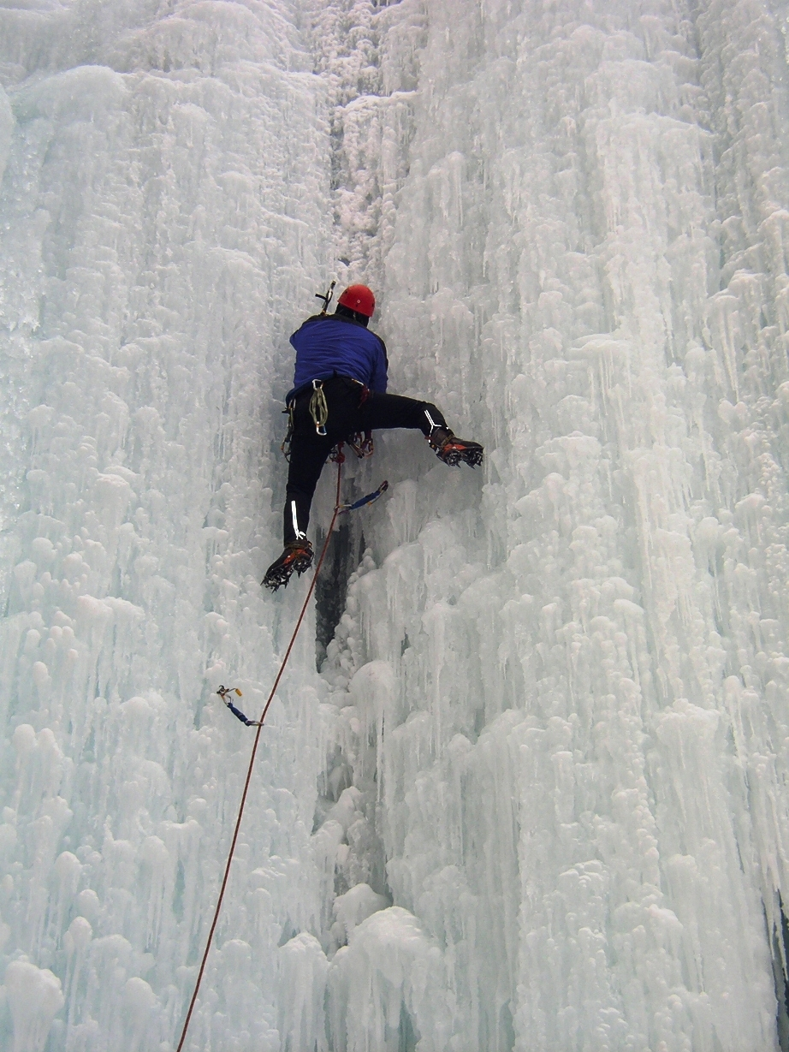
Cooler temperatures
© Dr Delia Roberts 2011
© Dr Delia Roberts 2011
Less impact at colder temperatures
Decrement was only 3% at 2°C
© Dr Delia Roberts 2011
© Dr Delia Roberts 2011
© Dr Delia Roberts 2011
Lower heat load allows blood to be retained in core
Increased risk of frostbite
© Dr Delia Roberts 2011
© Dr Delia Roberts 2011
© Dr Delia Roberts 2011

Slide 5
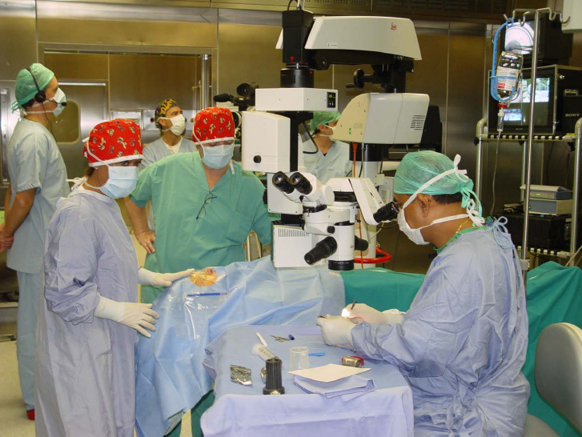
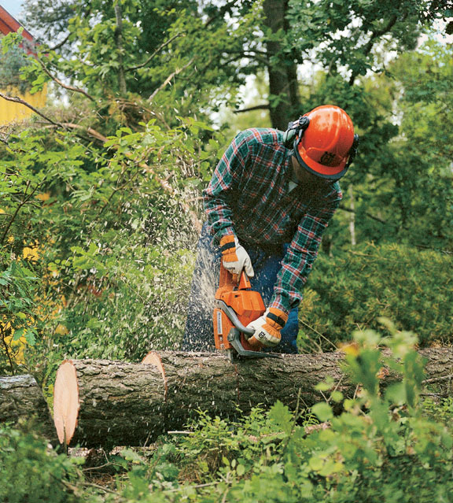
© Dr Delia Roberts 2011
© Dr Delia Roberts 2011
Performance impacted with only 2% loss body mass
-moderate working temperatures (10 – 15 °C)
Decreased speed and accuracy
Visuomotor
Psychomotor
Cognitive
© Dr Delia Roberts 2011
© Dr Delia Roberts 2011
© Dr Delia Roberts 2011
© Dr Delia Roberts 2011
© Dr Delia Roberts 2011
© Dr Delia Roberts 2011

Slide 6
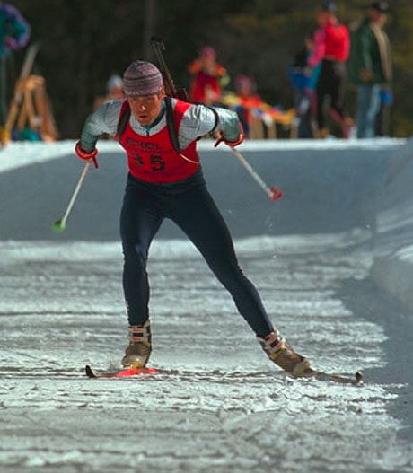
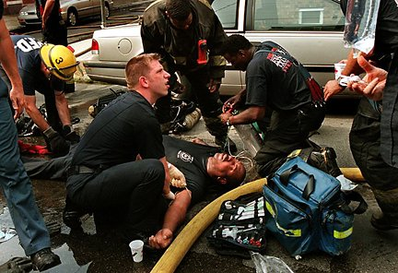
Consequence of loss of Performance
© Dr Delia Roberts 2011
© Dr Delia Roberts 2011
© Dr Delia Roberts 2011
Loss of work intensity
Heat illness
Loss of concentration
Accidents and injury
© Dr Delia Roberts 2011
© Dr Delia Roberts 2011
© Dr Delia Roberts 2011
© Dr Delia Roberts 2011
© Dr Delia Roberts 2011

Slide 7
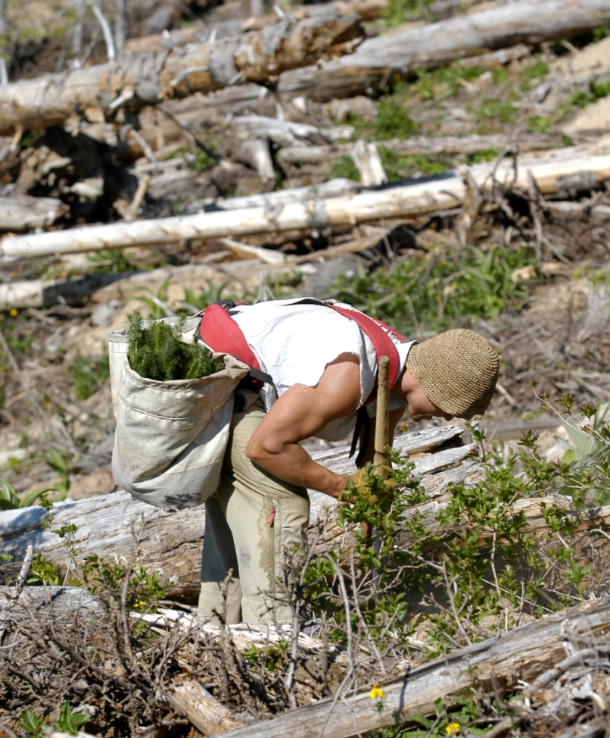
Hydration in the Workplace
© Dr Delia Roberts 2011
© Dr Delia Roberts 2011
Ambient heat:
Environmental conditions
Radiant and conductive heat
© Dr Delia Roberts 2011
© Dr Delia Roberts 2011
© Dr Delia Roberts 2011
© Dr Delia Roberts 2011
© Dr Delia Roberts 2011
© Dr Delia Roberts 2011

Slide 8
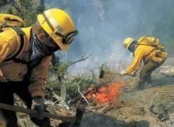
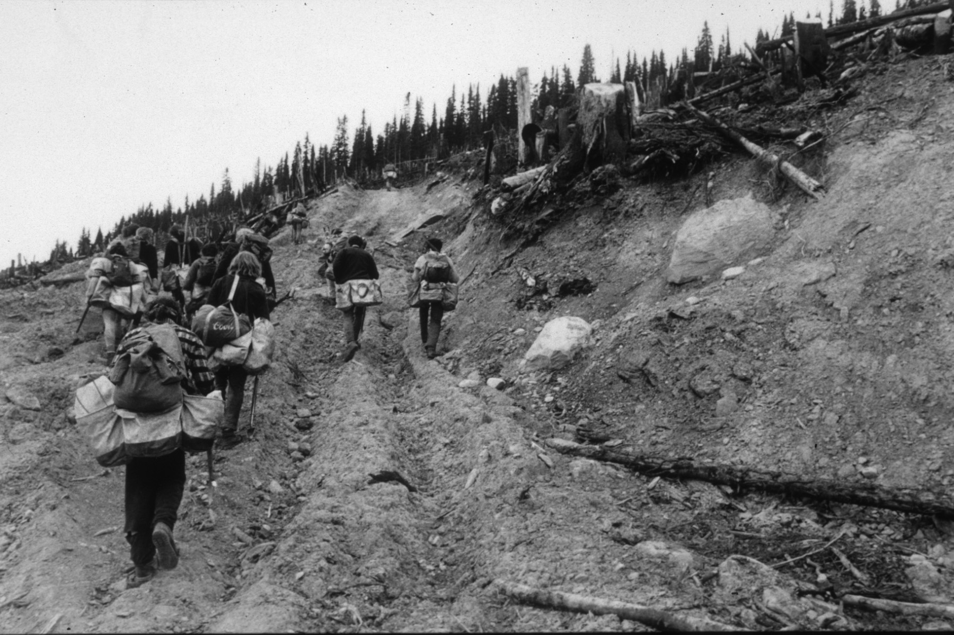
© Dr Delia Roberts 2011
© Dr Delia Roberts 2011
Access to fluids
© Dr Delia Roberts 2011
© Dr Delia Roberts 2011
© Dr Delia Roberts 2011
Physical work load
© Dr Delia Roberts 2011
© Dr Delia Roberts 2011
© Dr Delia Roberts 2011

Slide 9
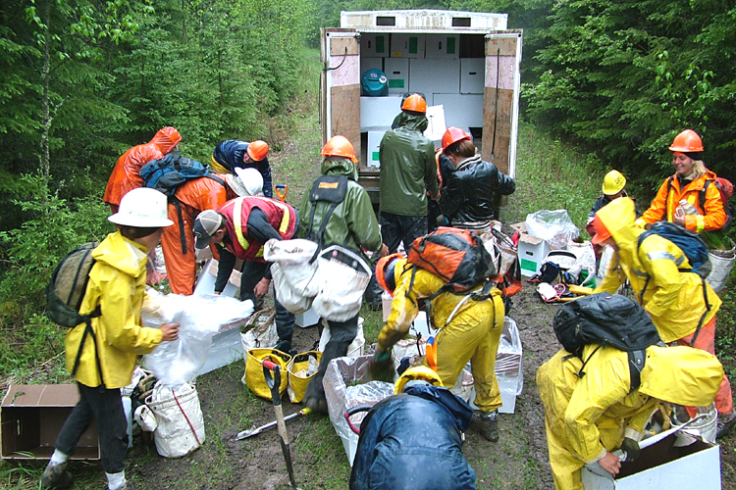
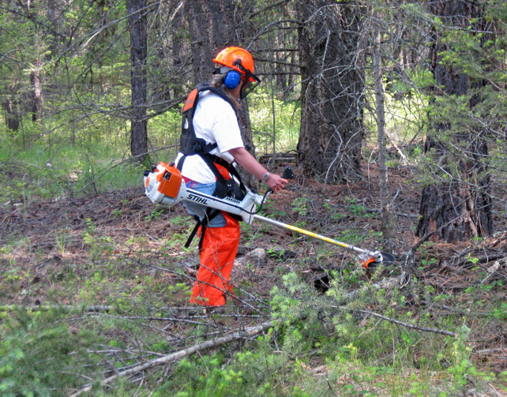
© Dr Delia Roberts 2011
© Dr Delia Roberts 2011
PPE
© Dr Delia Roberts 2011
© Dr Delia Roberts 2011
© Dr Delia Roberts 2011
© Dr Delia Roberts 2011
Restricted air flow
Decreases evaporative heat loss
© Dr Delia Roberts 2011
© Dr Delia Roberts 2011

Slide 10
© Dr Delia Roberts 2011
Sweat Rates
© Dr Delia Roberts 2011
Highly variable
Sweat rate
Salt content
Heat adapted sweat sooner and less salty
From 0.5 – 2.5 L/hour
40 – 60 mmol/L Na⁺
© Dr Delia Roberts 2011
© Dr Delia Roberts 2011
© Dr Delia Roberts 2011
© Dr Delia Roberts 2011
© Dr Delia Roberts 2011
More than 1 g salt/L sweat lost!
© Dr Delia Roberts 2011

Slide 11
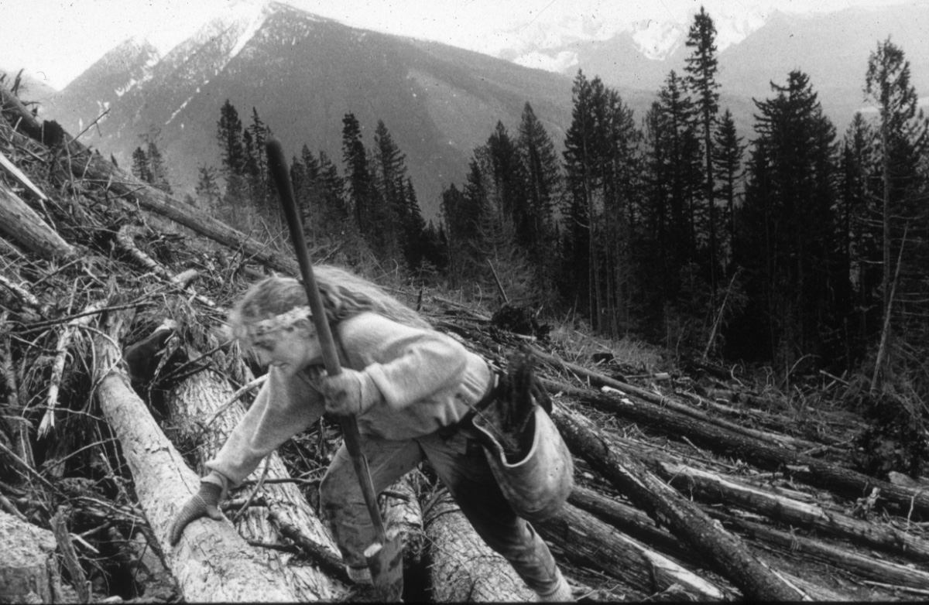
Tree Planting
© Dr Delia Roberts 2011
© Dr Delia Roberts 2011
© Dr Delia Roberts 2011
Very strenuous work load
© Dr Delia Roberts 2011
Hike 16 km
Plant 1500 – 3000 trees/day
Carry 20 – 30% body weight
© Dr Delia Roberts 2011
© Dr Delia Roberts 2011
© Dr Delia Roberts 2011
© Dr Delia Roberts 2011

Slide 12
More than 6 hours above 120 beats/min
© Dr Delia Roberts 2011
© Dr Delia Roberts 2011
© Dr Delia Roberts 2011
© Dr Delia Roberts 2011
© Dr Delia Roberts 2011
© Dr Delia Roberts 2011
© Dr Delia Roberts 2011
© Dr Delia Roberts 2011

Slide 13
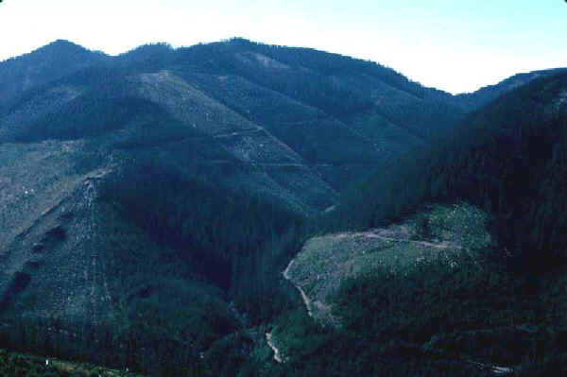
Limited Access
© Dr Delia Roberts 2011
© Dr Delia Roberts 2011
© Dr Delia Roberts 2011
© Dr Delia Roberts 2011
© Dr Delia Roberts 2011
© Dr Delia Roberts 2011
© Dr Delia Roberts 2011
© Dr Delia Roberts 2011

Slide 14
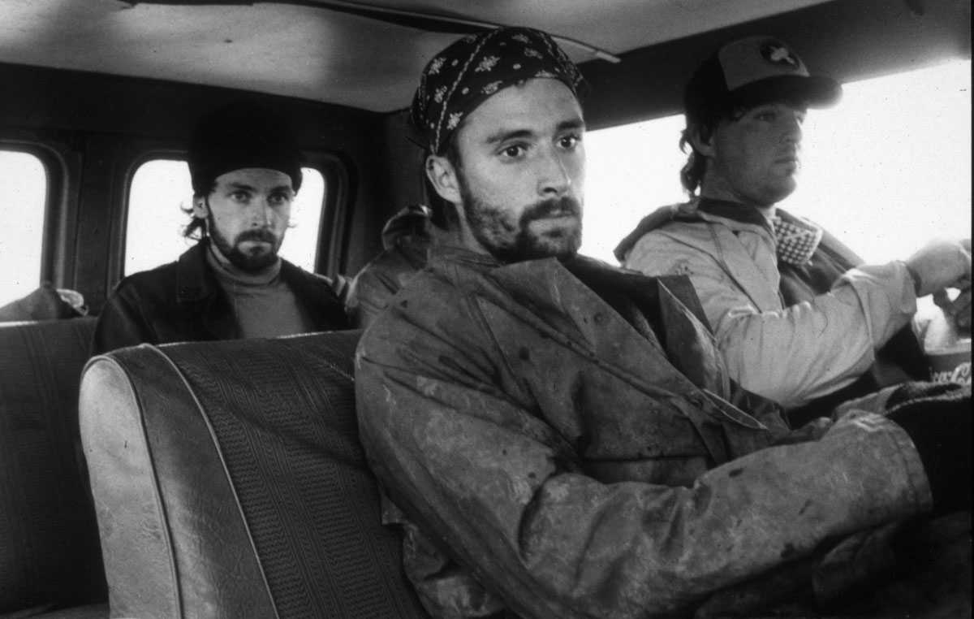
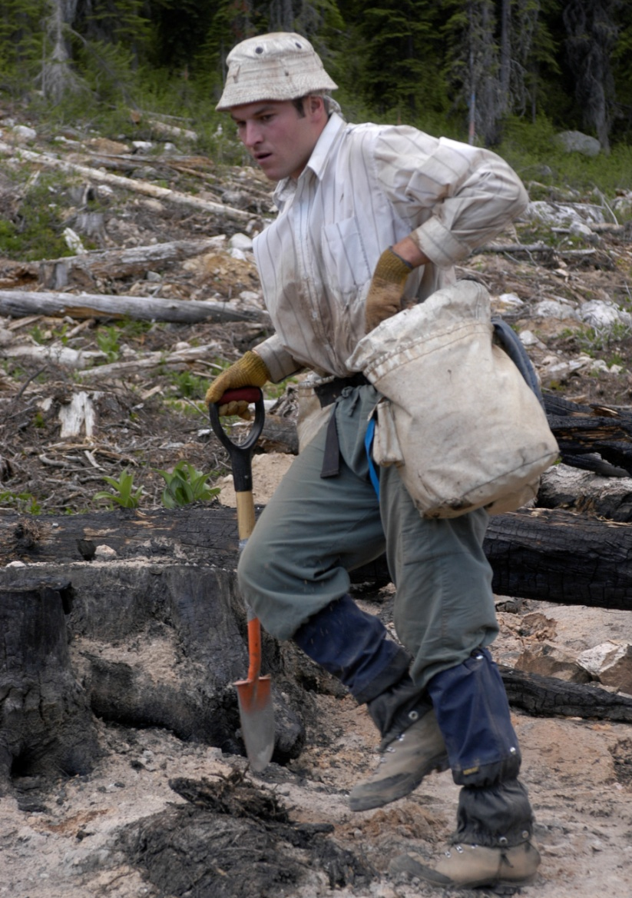
Dehydration under mild conditions
© Dr Delia Roberts 2011
© Dr Delia Roberts 2011
23.6 ± 4.5 °C and 58.6 ± 33.6% humidity
Mass loss -2.9 ± 1.8 %
With the consumption of 4.2 ± 1.7 L fluid!
© Dr Delia Roberts 2011
© Dr Delia Roberts 2011
© Dr Delia Roberts 2011
© Dr Delia Roberts 2011
© Dr Delia Roberts 2011
© Dr Delia Roberts 2011

Slide 15
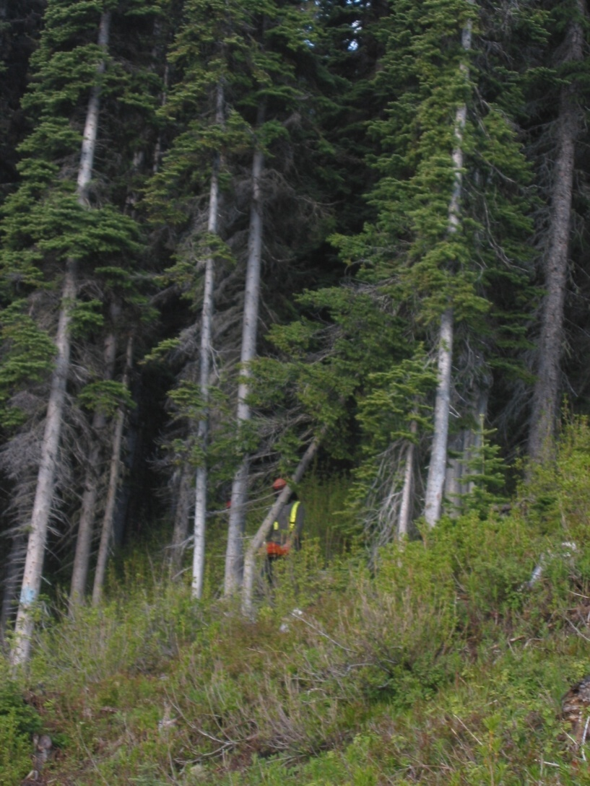
Timber Harvesting
© Dr Delia Roberts 2011
© Dr Delia Roberts 2011
© Dr Delia Roberts 2011
High work rate
213 ± 67 kcal/hr
3.7 ± 3.0 hr at > 40% VO₂max
© Dr Delia Roberts 2011
© Dr Delia Roberts 2011
© Dr Delia Roberts 2011
© Dr Delia Roberts 2011
© Dr Delia Roberts 2011

Slide 16
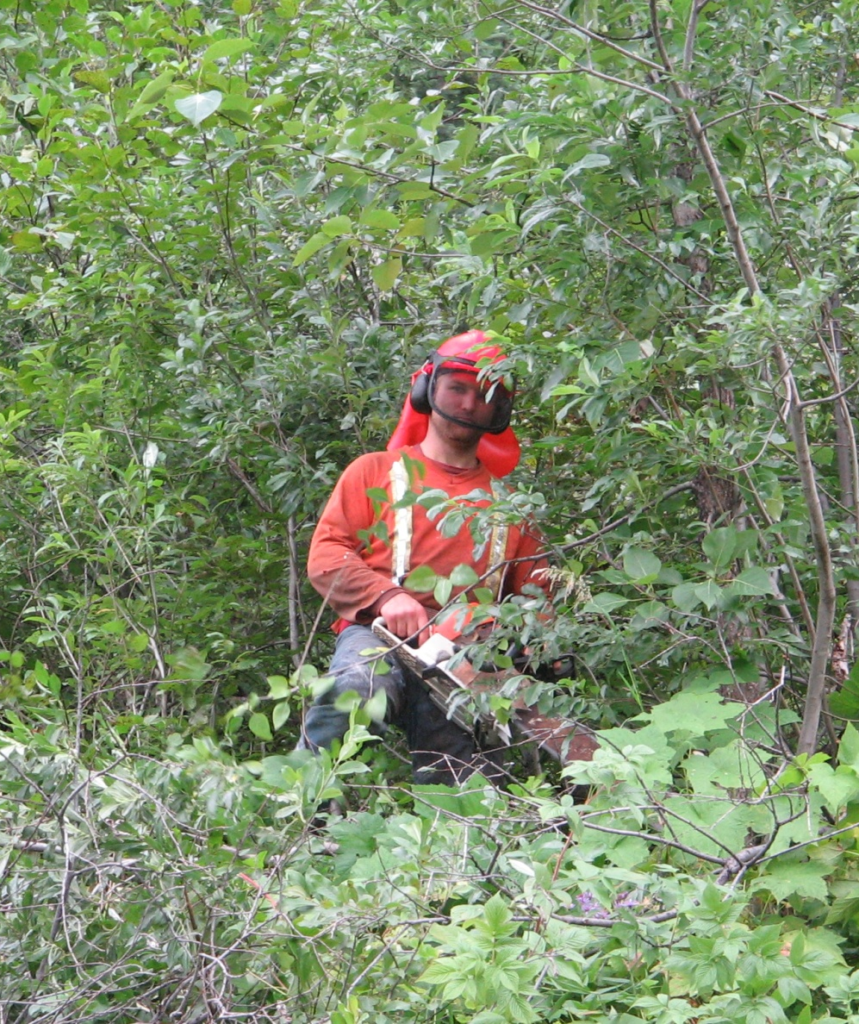
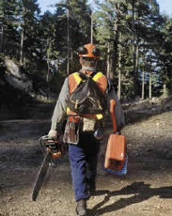
Formula for Hypohydration
© Dr Delia Roberts 2011
© Dr Delia Roberts 2011
PPE
Restricted access to fluid
© Dr Delia Roberts 2011
© Dr Delia Roberts 2011
© Dr Delia Roberts 2011
© Dr Delia Roberts 2011
© Dr Delia Roberts 2011
© Dr Delia Roberts 2011

Slide 17
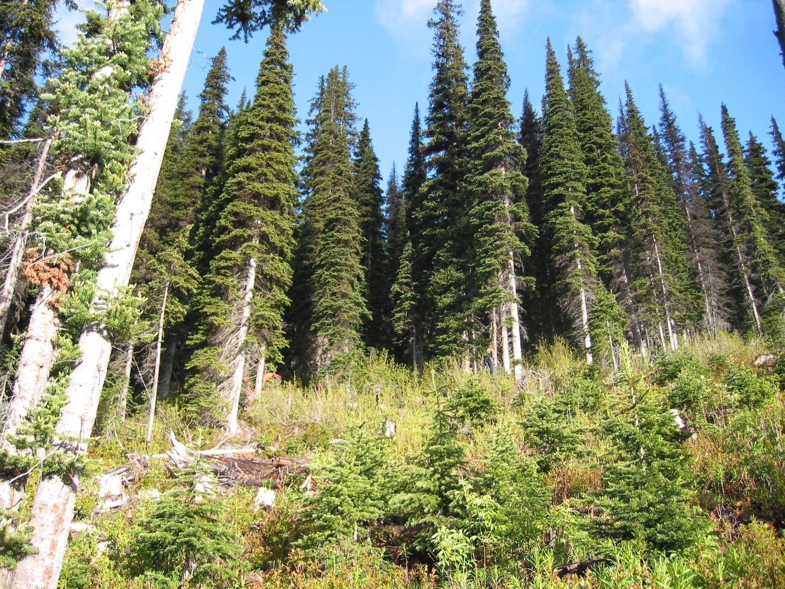
© Dr Delia Roberts 2011
Ambient conditions
© Dr Delia Roberts 2011
Mean ± SD | June | July | August
Ambient Temp (ºC) | 9.0 ± 2.4 | 16.4 ± 1.8 | 13.1 ± 1.8
Relative Humidity (%) | 79.6 ± 7.6 | 82.1 ± 7.8 | 74.3±7.5
© Dr Delia Roberts 2011
© Dr Delia Roberts 2011
© Dr Delia Roberts 2011
© Dr Delia Roberts 2011
© Dr Delia Roberts 2011
© Dr Delia Roberts 2011

Slide 18
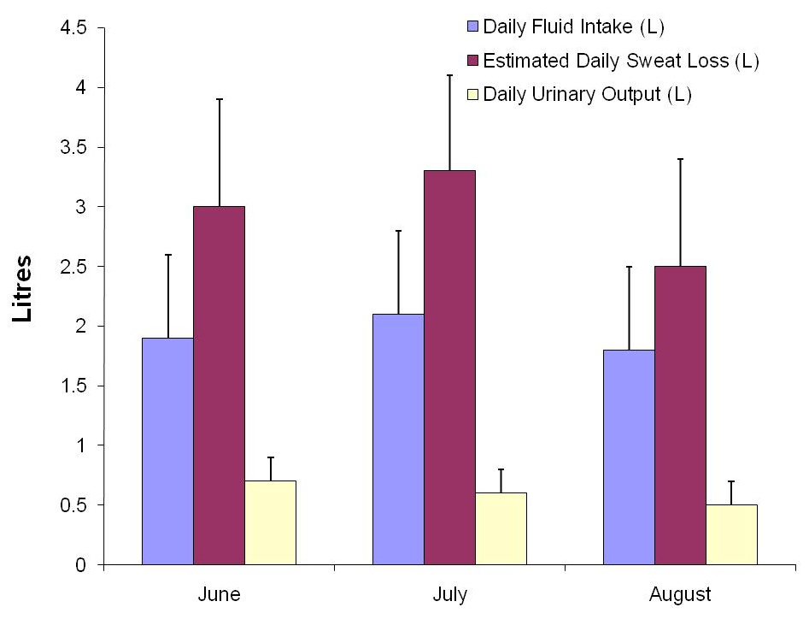
Fluid Balance
© Dr Delia Roberts 2011
© Dr Delia Roberts 2011
Body Mass Loss
June 2.1 ± 1.0%
July 2.1 ± 0.9%
Aug 1.7 ± 0.7%
© Dr Delia Roberts 2011
© Dr Delia Roberts 2011
© Dr Delia Roberts 2011
© Dr Delia Roberts 2011
© Dr Delia Roberts 2011
© Dr Delia Roberts 2011

Slide 19
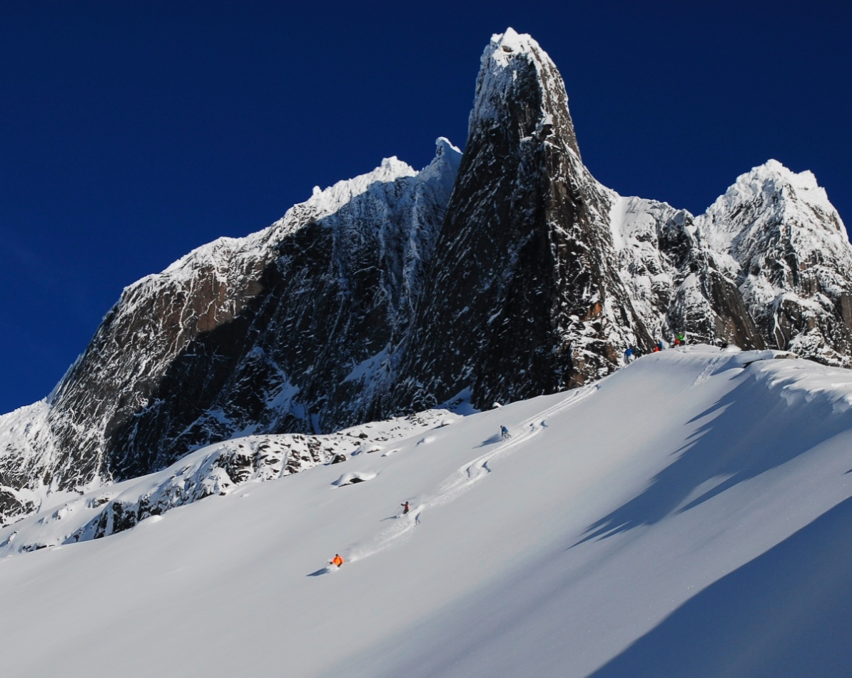
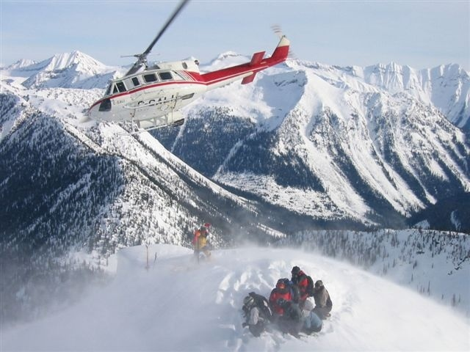
Winter Mountain Guides
© Dr Delia Roberts 2011
© Dr Delia Roberts 2011
Low ambient temperatures
Low humidity/altitude
Limited access to fluids
© Dr Delia Roberts 2011
© Dr Delia Roberts 2011
© Dr Delia Roberts 2011
© Dr Delia Roberts 2011
© Dr Delia Roberts 2011
© Dr Delia Roberts 2011

Slide 20
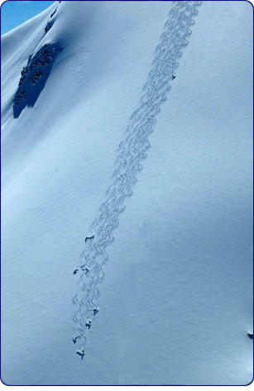
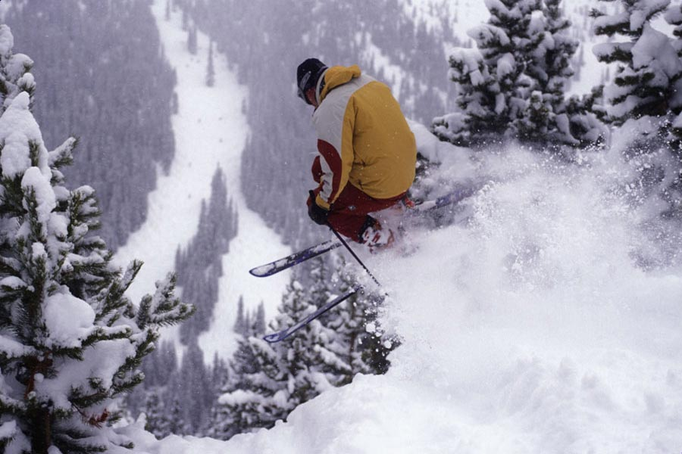
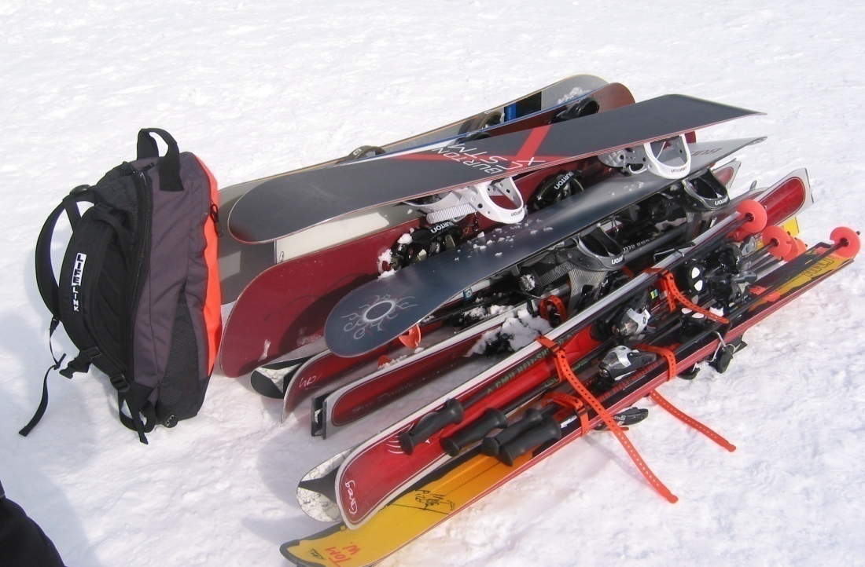
Workload
© Dr Delia Roberts 2011
Moderate
© Dr Delia Roberts 2011
6335 ± 558 m/day
load/unload 2580 ± 670 kg of skis/day
average daily heart rate 102 ± 13 bpm
118 ± 49 min at intensities >40% VO₂max
8.4 ± 10.6 min/day at >140 bpm
© Dr Delia Roberts 2011
© Dr Delia Roberts 2011
© Dr Delia Roberts 2011
© Dr Delia Roberts 2011
© Dr Delia Roberts 2011
© Dr Delia Roberts 2011

Slide 21
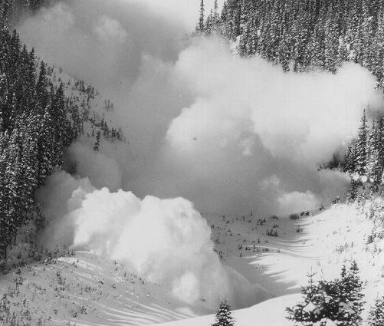
Voluntary Dehydration
© Dr Delia Roberts 2011
© Dr Delia Roberts 2011
Mean daily loss: 1.5 ± 1.0% body mass
50% of guides lost ≥2% body mass
Mean daily fluid intake: 1.2 ± 0.6 L
41% of individuals consumed less than 1.0 L
Impaired vigilance and decision making
© Dr Delia Roberts 2011
© Dr Delia Roberts 2011
© Dr Delia Roberts 2011
© Dr Delia Roberts 2011
© Dr Delia Roberts 2011
© Dr Delia Roberts 2011

Slide 22
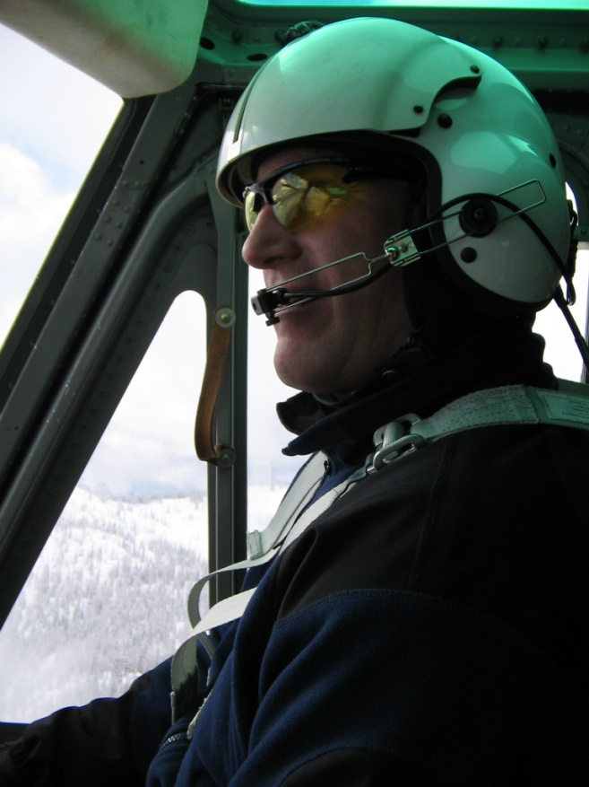
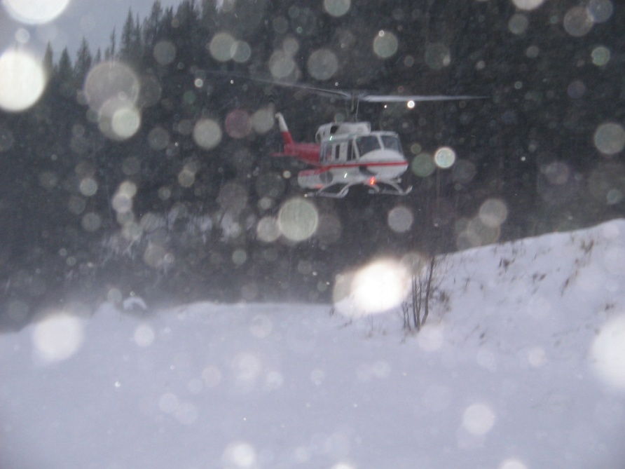
Helicopter Pilots
© Dr Delia Roberts 2011
© Dr Delia Roberts 2011
Dry cold environment
Limited access
Voluntary dehydration
© Dr Delia Roberts 2011
© Dr Delia Roberts 2011
© Dr Delia Roberts 2011
Pre to post work Δ body mass:
30% of pilots lost 2.4 ± 0.6%
© Dr Delia Roberts 2011
© Dr Delia Roberts 2011
© Dr Delia Roberts 2011

Slide 23
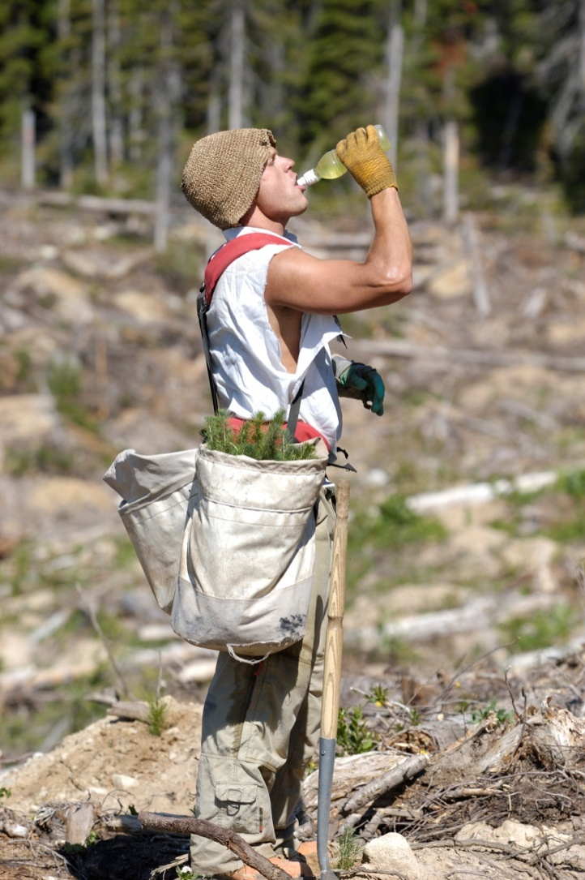
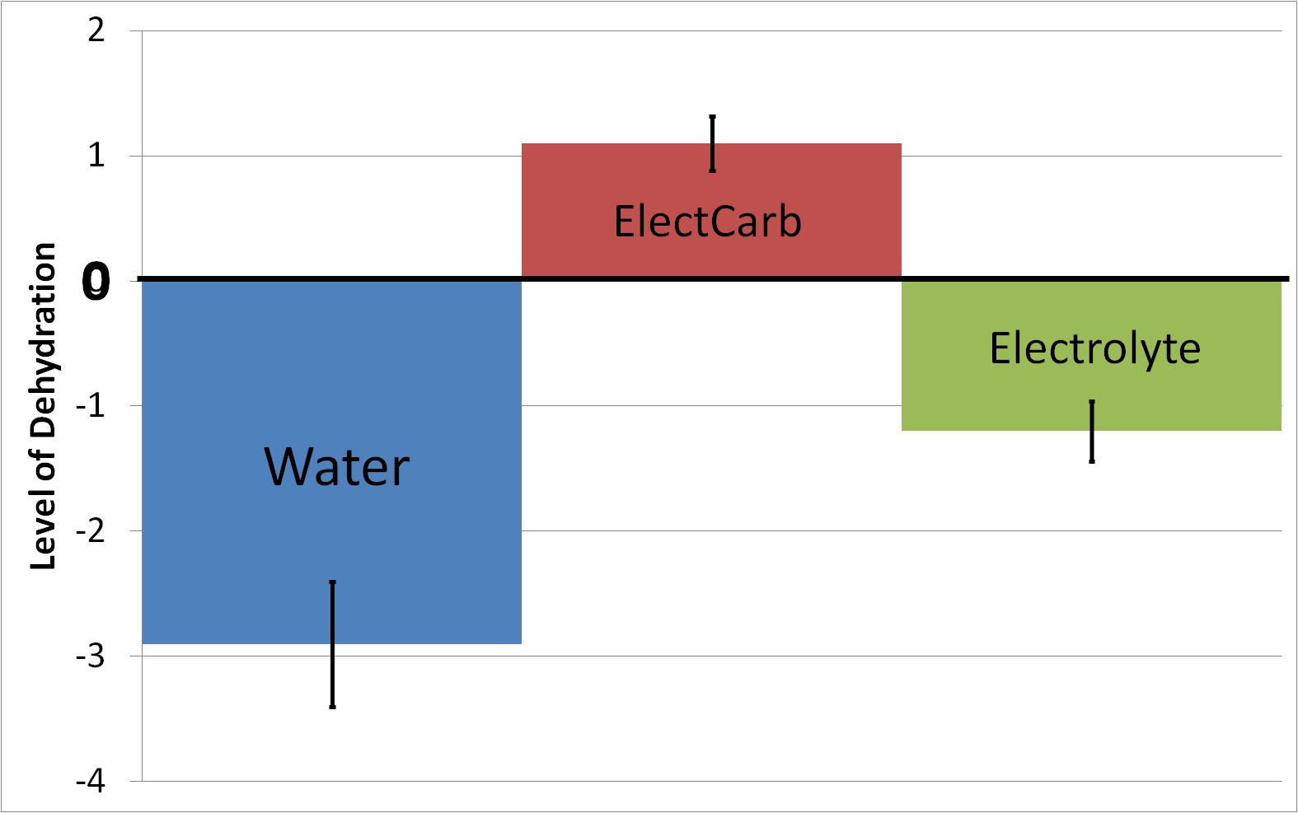
What should planters drink?
© Dr Delia Roberts 2011
© Dr Delia Roberts 2011
Beverages with some particulates are absorbed faster and are retained better than water
© Dr Delia Roberts 2011
© Dr Delia Roberts 2011
© Dr Delia Roberts 2011
© Dr Delia Roberts 2011
© Dr Delia Roberts 2011
© Dr Delia Roberts 2011

Slide 24
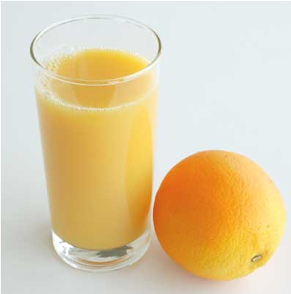
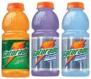
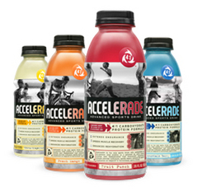
Composition
© Dr Delia Roberts 2011
© Dr Delia Roberts 2011
3 mEq/L potassium
18 mEq/L sodium
6 -10% carbohydrate
Protein??
Per litre of water:
60 gm or ¼ cup sugar
0.5 ml or 1/8 tsp salt
Pinch of potassium chloride
© Dr Delia Roberts 2011
© Dr Delia Roberts 2011
© Dr Delia Roberts 2011
© Dr Delia Roberts 2011
© Dr Delia Roberts 2011
© Dr Delia Roberts 2011

Slide 25
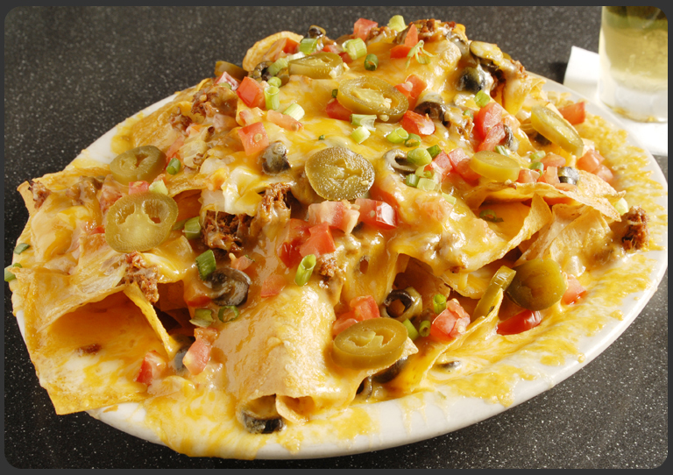
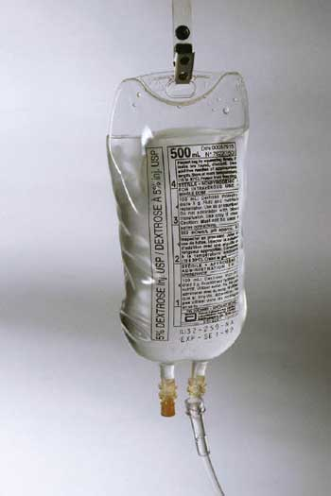
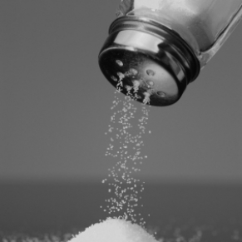
Hyponatremia
© Dr Delia Roberts 2011
© Dr Delia Roberts 2011
When sweat rates are high a significant amount of salt can be lost
Visible residue on dark clothing
If fluid is replaced without salt then cells cannot maintain their chemical or electrical balance
Same effect as over dilution
Planters consumed an average of 8 gm sodium/day from dietary sources
No additional sodium is necessary
© Dr Delia Roberts 2011
© Dr Delia Roberts 2011
© Dr Delia Roberts 2011
© Dr Delia Roberts 2011
© Dr Delia Roberts 2011
© Dr Delia Roberts 2011

Slide 26
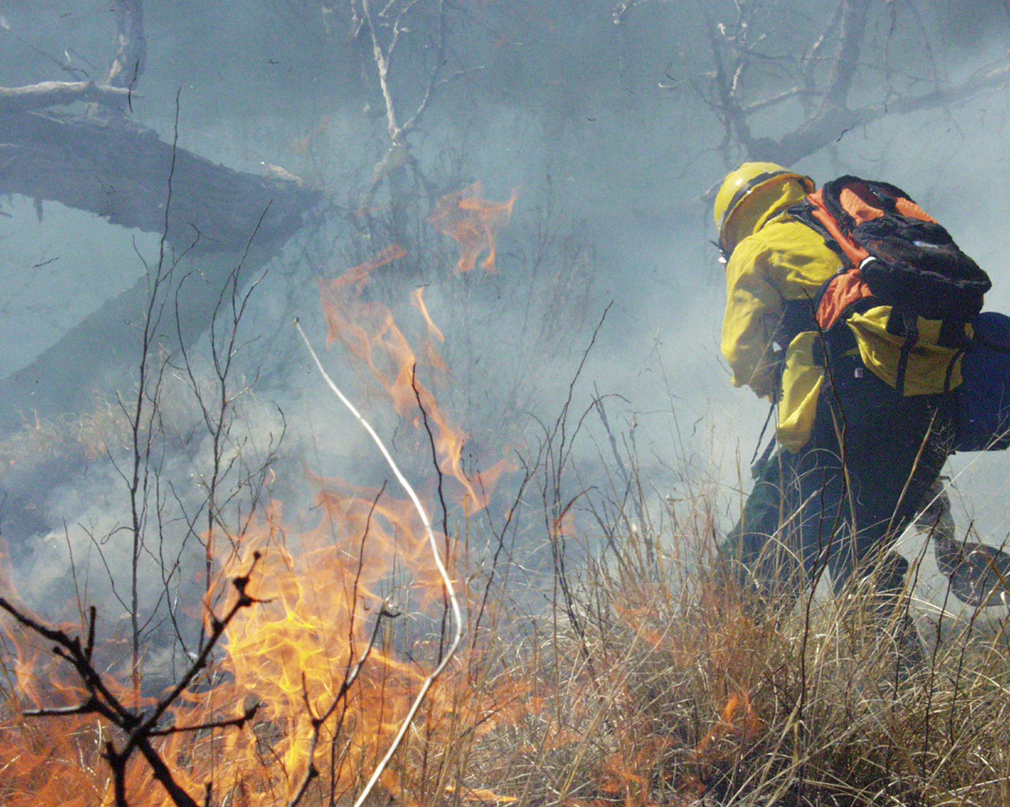
Pattern of Consumption
© Dr Delia Roberts 2011
© Dr Delia Roberts 2011
PPE and restricted access →
consumption is by bolus
Replace lost volume within 1 hr →
Only 55% of fluid consumed is retained
12.5% replacement over 4 hr →
75% of fluid consumed is retained
© Dr Delia Roberts 2011
© Dr Delia Roberts 2011
© Dr Delia Roberts 2011
© Dr Delia Roberts 2011
© Dr Delia Roberts 2011
© Dr Delia Roberts 2011

Slide 27
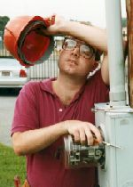
Promoting Hydration
© Dr Delia Roberts 2011
© Dr Delia Roberts 2011
Metered drinking
500 ml/hour
Salty sweaters show white streaks
Carry extra water/electrolyte beverage
© Dr Delia Roberts 2011
© Dr Delia Roberts 2011
© Dr Delia Roberts 2011
© Dr Delia Roberts 2011
© Dr Delia Roberts 2011
© Dr Delia Roberts 2011

Slide 28
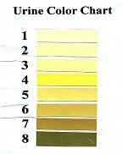
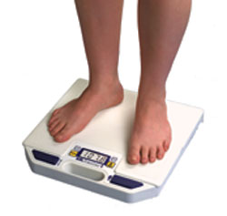
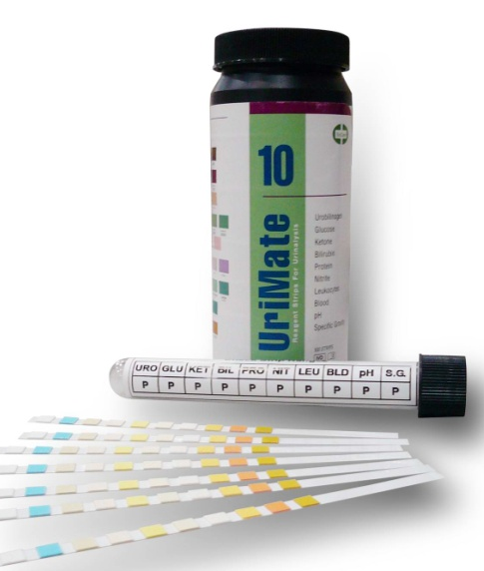
Monitoring Fluid Loss
© Dr Delia Roberts 2011
© Dr Delia Roberts 2011
© Dr Delia Roberts 2011
Convenience in the workplace
Urine color
Body mass loss
Specific gravity
© Dr Delia Roberts 2011
© Dr Delia Roberts 2011
© Dr Delia Roberts 2011
© Dr Delia Roberts 2011
© Dr Delia Roberts 2011

Slide 29
Implementation
© Dr Delia Roberts 2011
© Dr Delia Roberts 2011
© Dr Delia Roberts 2011
© Dr Delia Roberts 2011
www.selkirk.ca/treeplanting
© Dr Delia Roberts 2011
© Dr Delia Roberts 2011
© Dr Delia Roberts 2011
© Dr Delia Roberts 2011

Slide 30
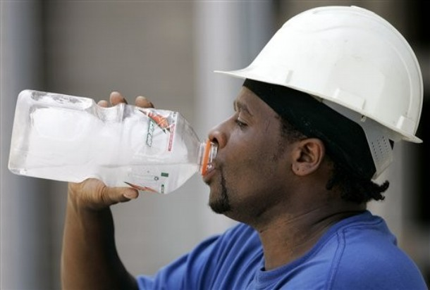
Conclusions
© Dr Delia Roberts 2011
© Dr Delia Roberts 2011
© Dr Delia Roberts 2011
Hydration is an important consideration in workplace performance
Occupational hydration strategies must take into account the
workplace environment
workplace culture
the chronic nature of the exposure
© Dr Delia Roberts 2011
© Dr Delia Roberts 2011
© Dr Delia Roberts 2011
© Dr Delia Roberts 2011
© Dr Delia Roberts 2011

Slide 31
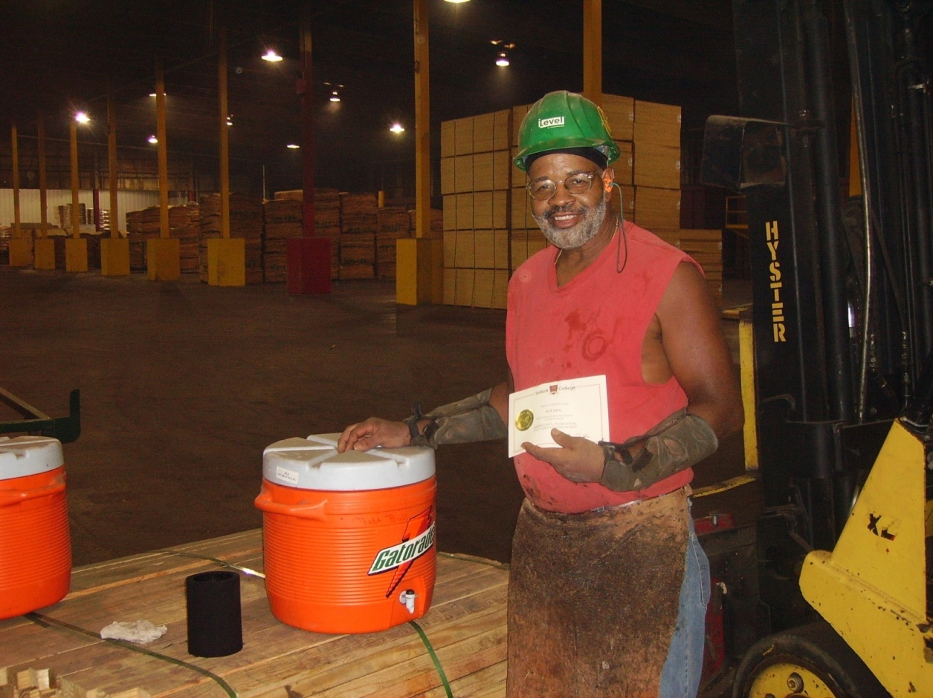
Acknowledgements
© Dr Delia Roberts 2011
© Dr Delia Roberts 2011
© Dr Delia Roberts 2011
© Dr Delia Roberts 2011
© Dr Delia Roberts 2011
© Dr Delia Roberts 2011
© Dr Delia Roberts 2011
© Dr Delia Roberts 2011

